Slide 1
ChipTrust Security IP - MicroArchitecture
Jishnu Mohan
Lokesh Kumbaganti
Sravanthi Vennapusa

Slide 3
Architecture

Slide 4
SoC (host chip)
.cptra_pwrgood .cptra_rst_b .fuse writes .AXI manager .TAP/JTAG
AXI subordinate
Chip Trust IP boundary
Firmware stack (SW – runs on VeeR EL2)
ROM (96 KiB)
FMC
Runtime FW
VeeR EL2 RISC-V core (32-bit, 4-stage in-order pipeline)
.IFU (AHB-Lite) .LSU (AHB-Lite) .31 external IRQs .PMP enabled .WDT NMI .ICCM 256 KiB .DCCM 256 KiB
AHB-Lite fabric (32-bit addr, 64-bit data, 17 targets)
AHB-Lite Interconnect – address decoder routes to 17 target slaves
Crypto subsystem
Peripherals
SoC interface
Chip Trust outputs to SoC
.ready_for_fuses .ready_for_fw .error_fatal .error_non-fatal .security_state .idevid_cert_chain

Slide 5
Firmware Stack
Firmware stack (SW – runs on VeeR EL2)
ROM (96 KiB - immutable)
First code executed
UDS decrypt
Mailbox enable
Asserts READY_FOR_FW
FMC (First Mutable Code)
DICE cert chain build
IDevID → LDevID
Loads runtime firmware
Verifies signature
Runtime FW
Post-boot services
Attestation requests
Crypto services
WDT servicing
Impactless FW update

Slide 6
Crypto subsystem, Peripherals and SoC Interface Blocks
Crypto subsystem 0x1000_0000
Peripherals 0x2000_0000
SoC Interface 0x3000_0000
Crypto Init Engine (CIE)
UDS / field entropy derive
CSRNG
Crypto-secure RNG 0x2000_2000
Mailbox FSM + SRAM 256 KiB
.FW load .protocol lock
0x3002_0000/0x3004_0000
Crypto subsystem
Crypto Init Engine (CIE)
ECC Secp384 (ECDSA)
Sign/verify – 0x1000_8000
Entropy source
Physical RNG seed
0x2000_3000
AXI DMA Assist Engine
Streaming SHA/AES-LOCK
0x3002_2000
ECC Secp384 (ECDSA)
HMAC-512
MAC engine – 0x1001_0000
Watchdog timer
2-stage cascade NMI on timeout
SHA-512/ SHA-256
Hash – 0x1002_0000
SoC IFC CSR
.Fuse regs .timer .flow ctrl
0x3003_0000
HMAC-512
SHA-512/ SHA-256
ICCM 256 KiB
Instruction memory
0x4000_0000
AES-128/192/256
ECB CBC CFB OFB CTR GCM
SHA-512 Accelerator
Save/restore .streaming
0x3002_1000
AES-128/192/256
ABR-ML-DSA/ ML-KEM
Adams Bridge – 0x1003_0000
ABR-ML-DSA/ ML-KEM
DCCM 256 KiB
Data memory
0x5000_0000
TAP/JTAG
Debug/auth breakpoint
AXI subordinate
SoC inbound
R/W access
SHA3
0x1004_0000
Key Vault
0x1001_8000
SHA3
KeyVault
PCR Vault + Data Vault
Boot FSM
FUSE→DONE states
PCR Vault + Data Vault
Measurement storage
AXI manager (outbound)
Chip Trust initiates SoC reads

Slide 7
MicroArchitecture

Slide 8
Phase 1-4: power on/boot fsm/fuse programming/firmware load
SoC
AXI Interface
Boot FSM
VeeR EL2
Crypto
Mailbox
cptra_pwrgood
cptra_rst_b (deassert)
BOOT_IDLE
ready_for_fuses
fuse_req_interrupt
AXI write: fuse_uds
AXI write: fuse_field_entropy
AXI write: fuse_done = 1
fuse_done
cptra_uc_rst_b_deassert
ROM executes
AHB read: mailbox_SRAM
fw_data[31:0]
FW loaded
ICCM

Slide 9
Phase 5: Crypto Operations
SoC
AXI Interface
Boot FSM
VeeR EL2
Crypto
Mailbox
AHB_write: sha512_block
sha512_valid
AHB_write: ecc_cmd
ecc_valid
AHB_write: hmac_key, block
hmac_valid
AHB_write: pcr_extend
pcr_valid

Slide 10
Phase 6: Mailbox Command
SoC
AXI Interface
Boot FSM
VeeR EL2
Crypto
Mailbox
AXI write: mbox_lock
lock granted
AXI write: mbox_cmd, mbox_dlen
AXI write: mbox_datain
AXI write: mbox_execute = 1
mbox_notif interrupt
AHB_read: mbox_cmd, data

Slide 11
Phase 7: Attestation Response
SoC
AXI Interface
Boot FSM
VeeR EL2
Crypto
Mailbox
AHB_write: ecc_sign_r/s
ecc_sign_valid
AHB_write: mbox_dataout
AHB_write: mbox_status = DATA_READY
mbox_data_avail interrupt
AXI read: mbox_dataout
cert/signature data
AXI write: mbox_unlock = 1

Slide 13
MicroArchitecture Block Diagram - VeeREL2 RISC V Core

Slide 14
Interface Signal List - VeeREL2 RISC V Core

Slide 15
CWTRUST MicroArchitecture Design Hierarchy – VeeREL2 RISC V Core

Slide 16
Crypto

Slide 17
SoC IFC

Slide 18
PM Reduction Techniques in Security IP

Slide 20
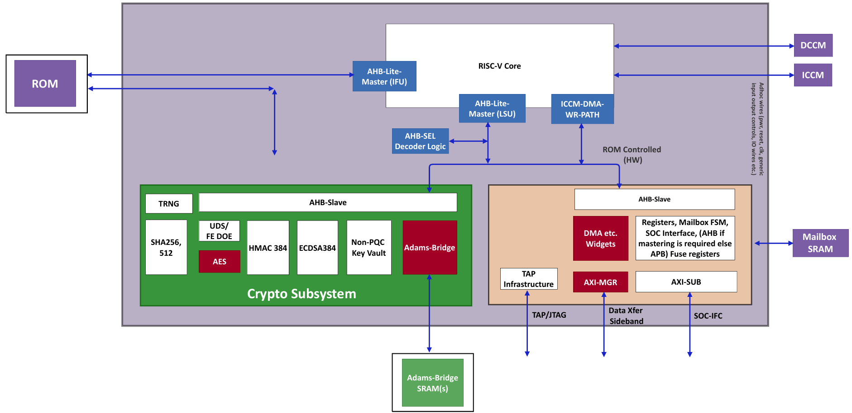
Caliptra High Level Block Diagram
Fig. 1 Caliptra high level block diagram

Slide 21
SROM Introduction
SROM module is AHB-Lite compliant slave interface
64-bit read data path
Word-aligned (addresses are arranged according to the size of the data word) SROM addressing
Read-only protection
Any write access generates an AHB ERROR response
Single-cycle ROM read datapath
Simple chip-select-based SROM access mechanism
Supports 64-bit read data transfers
32-bit address

Slide 22
SROM Block Diagram
Read Request from AHB
Chip Select Generation
Write Access Check
Address Generation & Alignment
External IMEM / ROM Array
Error Pipeline Registers
AHB Response Logic
Fig. 2 SROM block diagram

Slide 23
SROM Pin Diagram
AHB SROM Interface
hclk
hreset_n
hsel_i
hwrite_i
hresp_o
hready_i
hreadyout_o
htrans_i
2
cs
hsize_ i
3
31
addr
haddr_i
32
64
hrdata_o
hwdata_i
64
rdata
64
Fig. 3 SROM pin diagram

Slide 24
SROM Signal Descriptions
Signal | Width | Direction | Description
hclk | 1 | input | AHB clock signal
hreset_n | 1 | input | Active low reset signal
hsel_i | 1 | input | AHB slave select signal
hwrite_i | 1 | input | AHB write control signal
hready_i | 1 | input | Indicates valid and ready AHB transfer
htrans_i | 2 | input | AHB transfer type signal
hsize_i | 3 | input | AHB transfer size indication
haddr_i | 32 | input | AHB address input
hwdata_i | 64 | input | AHB write data input (unused for ROM writes)
rdata | 64 | input | Read data returned from SROM array
hresp_o | 1 | output | AHB response signal indicating OKAY or ERROR
hreadyout_o | 1 | output | AHB ready response signal
Table 1 SROM signal descriptions

Slide 25
SROM Signal Descriptions (Contd..)
Signal | Width | Direction | Description
cs | 1 | output | Chip select signal for SROM access
addr | 32 | output | Word-aligned address sent to SROM array
hrdata_o | 64 | output | Read data output returned to AHB master
Table 1 SROM signal descriptions

Slide 26
SROM Working
Read Operation
AHB interface detects valid AHB read transfer (NONSEQ / SEQ)
Generates chip select signal (cs) for valid memory access
Receives byte address through AHB address channel of 32 bits
Performs word-aligned address generation
Sends aligned address to external ROM memory
External memory returns read data through AHB read channel, having 64 bits
Generates successful AHB response H_OKAY
SROM Write Error Handling
SROM supports only read operations
Detects invalid write access when: chipselect is high, and the AHB write signal is asserted
Generates internal error signal for write operation

Slide 27
Fetch Control Introduction
Generates and manages next fetch addresses
Controls instruction fetch requests to instruction memory/cache
Handles pipeline flush, replay, and redirect operation
Detects ICCM and uncacheable memory accessess
Handles instruction cache miss recovery
Uses FSM-based fetch sequencing and control

Slide 28
Fetch Control Block Diagram
Flush/Redirect Control
Fetch Address Selection Mux
Flush Path
Miss Replay Path
Branch Predictor Target Path
Sequential Path
Sequential Address Generator
Fetch Address Pipeline Reg
Fetch Request Generation
Fetch Buffer Tracking
Fetch FSM / Stall FSM
IDLE, FETCH, STALL, WFM
DMA/ Stall Control
ICCM Range Checker
Uncacheable Region Check
PMU Fetch Stall Monitor
Fig. 4 Fetch control path block diagram

Slide 29
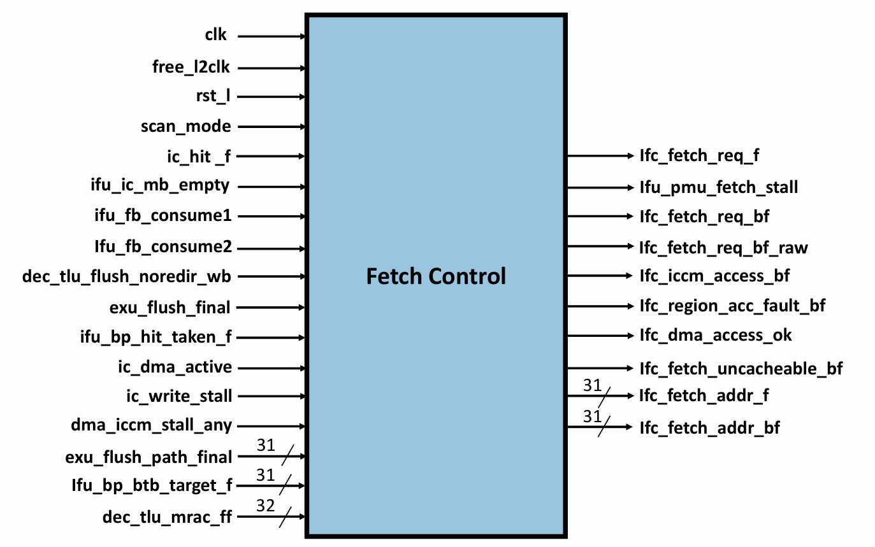
Fetch Control Pin Diagram
Fig. 5 Fetch control pin diagram

Slide 30
Fetch Control Signal Descriptions
Signal | Width | Direction | Description
clk | 1 | input | Active core clock signal
free_l2clk | 1 | input | Free-running clock signal
rst_l | 1 | input | Active low reset signal
scan_mode | 1 | input | Scan/test mode control
ic_hit_f | 1 | input | Indicates instruction cache hit in fetch stage
ifu_ic_mb_empty | 1 | input | Indicates instruction cache miss buffer empty
ifu_fb_consume1 | 1 | input | Instruction aligner consumed one fetch buffer entry
ifu_fb_consume2 | 1 | input | Instruction aligner consumed two fetch buffer entries
dec_tlu_flush_noredir_wb | 1 | input | Flush request without fetch redirection
exu_flush_final | 1 | input | Final pipeline flush signal
Table 2 Fetch control signal descriptions

Slide 31
Fetch Control Signal Descriptions
Signal | Width | Direction | Description
ifu_bp_hit_taken_f | 1 | input | Branch predictor indicates branch has taken
ic_dma_active | 1 | input | Indicates active instruction cache DMA operation
ic_write_stall | 1 | input | Instruction cache write stall signal
dma_iccm_stall_any | 1 | input | DMA ICCM access stall indication
exu_flush_path_final | 31 | input | Redirect fetch address after pipeline flush
ifu_bp_btb_target_f | 31 | input | Predicted branch target address from BTB
dec_tlu_mrac_ff | 32 | input | Region cacheability and side-effect attributes
ifc_fetch_req_f | 1 | output | Qualified fetch request in fetch stage
ifu_pmu_fetch_stall | 1 | output | PMU indication for instruction fetch stall
ifc_fetch_req_bf | 1 | output | Fetch request in BF stage
ifc_fetch_req_bf_raw | 1 | output | Raw fetch request before stall qualification
ifc_iccm_access_bf | 1 | output | Indicates fetch access targets ICCM
Table 2 Fetch control signal descriptions

Slide 32
Fetch Control Signal Descriptions
Signal | Width | Direction | Description
ifc_region_acc_fault_bf | 1 | output | Indicates invalid ICCM region access fault
ifc_dma_access_ok | 1 | output | Indicates DMA can safely proceed
ifc_fetch_uncacheable_bf | 1 | output | Indicates fetch access is uncacheable
ifc_fetch_addr_f | 31 | output | Fetch address in fetch stage
ifc_fetch_addr_bf | 31 | output | Fetch address in BF stage
Table 2 Fetch control signal descriptions

Slide 33
Fetch Control Working
Flush / Redirect Control detects flush conditions caused by:
Branch misprediction
Exception
Interrupt
The fetch logic redirects instruction fetch (updated PC) and prevents wrong instructions from continuing in the pipeline
Fetch Address Selection Mux :
Selects next fetch address from multiple sources:
Flush path : removes invalid instruction flow
Miss Replay path : Previous fetch failed, or a cache miss happened
Branch predictor path: when branch predictor predicts the branch taken or not then IFU fetches from the branch target buffer

Slide 34
Fetch Control Working (Contd..)
Fetch Address Selection Mux : (Contd..)
Selects next fetch address from multiple sources: (Contd..)
Sequential path : current PC + next instruction offset
Sequential Address Generator : increments address
Fetch Address Pipeline Register : synchronises fetch pipeline timing
Fetch Request Generation: Generates fetch requests to the instruction cache/memory
Raw fetch request
Qualified fetch request :
Fetch request allowed only when:
Buffer not full
No DMA stall
No write stall
No flush blocking

Slide 35
Fetch Control Working (Contd..)
Fetch Buffer Tracking :
Instruction fetch and instruction decode may run at different speeds in order to have synchronization, a fetch buffer is used
Tracks fetch buffer usage.
Monitors:
Buffer writes
Buffer full condition
Instruction consumption
Prevents fetch buffer overflow, based write operations, buffer full signal, and also how many instruction consumed
Fetch FSM / Stall FSM : IDLE , FETCH, WFM (Wait For Miss)

Slide 36
Fetch Control Working (Contd..)
Fetch FSM : IDLE , FETCH, WFM (Wait For Miss) (Contd..)
goto_idle
It controls how the processor:
fetches instructions
waits during cache miss/stall
and resumes fetching again
How long wait ?
IDLE
goto_idle
fetch_req & ~goto_idle
miss_pending & ~goto_idle
goto_idle
cache_hit & ~stall & ~goto_idle
WFM
FETCH
miss_done & ~goto_idle
miss_f & ~goto_idle

Slide 37
Fetch Control Working (Contd..)
DMA / Stall Control :
Detects DMA and instruction cache stall conditions.
Temporarily pauses instruction fetching while DMA operations are active.
Signals fetch pipeline stalls during ICCM DMA accesses.
Blocks fetch requests while instruction cache write operations are in progress.
Prevents resource conflicts between the IFU, DMA, and instruction cache.
Resumes normal instruction fetching when the stall condition is removed.
Note : IFU can access instructions from -> ICache / ICCM / Memory

Slide 38
Fetch Control Working (Contd..)
ICCM Range Checker :
Checks whether fetch address belongs to ICCM region
Uncacheable Region Check :
Detects uncacheable memory regions
Such accesses bypass the instruction cache.
Uncacheable memory is used for:
Device memory
Peripheral regions
Special hardware blocks
PMU Fetch Stall Monitor :
Monitors fetch stall conditions. Indicates stalls caused by: cache misses, full buffers, DMA stalls
Sends performance information to PMU

Slide 39
SoC Address Decode & Arbitration
The SoC Interface Address Decode & Arbitration is the central arbitration and address decoding block used in the SoC Interface subsystem.
The module receives requests from two masters, namely the UC (Microcontroller) and the external SoC, and routes these requests to different internal peripherals such as the Mailbox, SHA Engine, DMA Register block, and SOC IFC Register block.
The arbiter performs address decoding by checking the incoming request address against predefined address ranges. Based on the decoded address, the request is directed to the corresponding destination block.
The module also validates access permissions for protected resources such as the Mailbox, SHA engine, and Fuse registers using user validation signals.

Slide 40
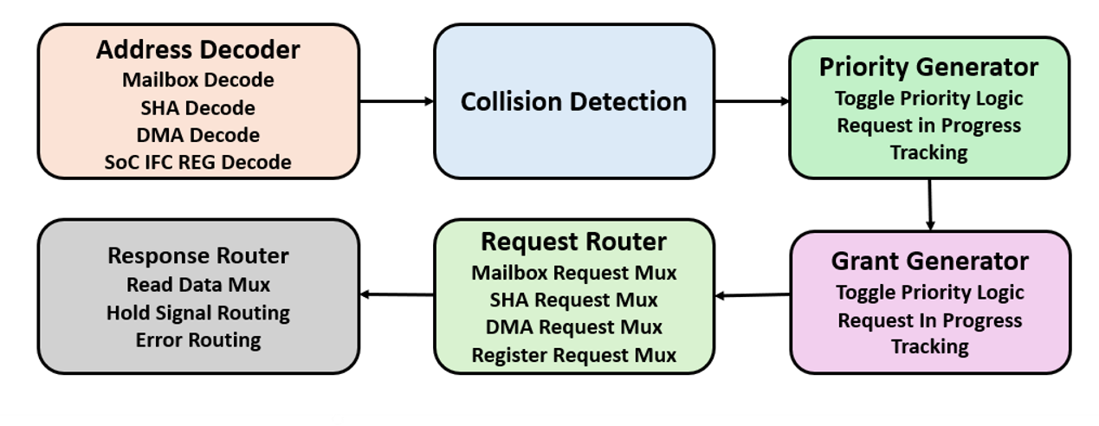
Block Diagram of SoC Address Decode & Arbitration
Fig 1.Block Diagram of Address Decode & Arbitration

Slide 41
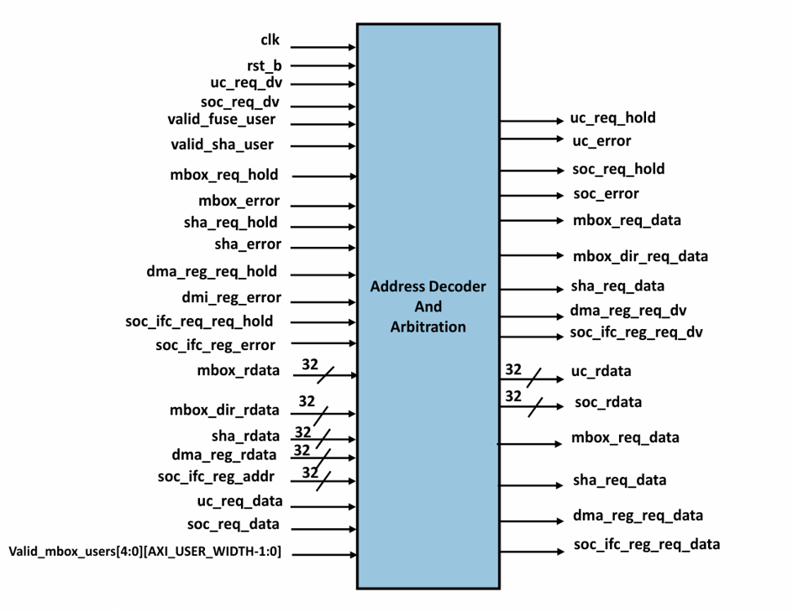
Pin Diagram of SoC Address Decode & Arbitration
Fig 2.Pin Diagram of Address Decode & Arbitration

Slide 42
Address Decode & Arbitration Input Signal Description
Table 1.Inputs of Address Decode & Arbitration
Signal Name | Width | Direction | Description
clk | 1 | Input | System clock
rst_b | 1 | Input | Active low reset
uc_req_dv | 1 | Input | UC request valid signal
soc_req_dv | 1 | Input | SoC request valid signal
valid_fuse_user | 1 | Input | Valid fuse access user
valid_sha_user | 1 | Input | Valid SHA access user
mbox_req_hold | 1 | Input | Mailbox hold signal
mbox_error | 1 | Input | Mailbox error signal
sha_req_hold | 1 | Input | SHA hold signal
sha_error | 1 | Input | SHA error signal
dma_reg_req_hold | 1 | Input | DMA hold signal

Slide 43
Address Decode & Arbitration Input Signal Description
Table 2.Inputs of Address Decode & Arbitration
Signal Name | Width | Direction | Description
dma_reg_error | 1 | Input | DMA error signal
soc_ifc_reg_req_hold | 1 | Input | Register block hold signal
soc_ifc_reg_error | 1 | Input | Register block error signal
mbox_rdata | 32 | Input | Mailbox read data
mbox_dir_rdata | 32 | Input | Mailbox direct read data
sha_rdata | 32 | Input | SHA read data
dma_reg_rdata | 32 | Input | DMA read data
soc_ifc_reg_rdata | 32 | Input | Register block read data
uc_req_data | Struct | Input | UC request packet
soc_req_data | Struct | Input | SoC request packet
valid_mbox_users | Array | Input | Valid mailbox users array

Slide 44
Address Decode & Arbitration Output Signal Description
Table 3.Outputs of Address Decode & Arbitration
Signal Name | Width | Direction | Description
uc_req_hold | 1 | Output | Hold UC request
uc_error | 1 | Output | UC transaction error
soc_req_hold | 1 | Output | Hold SoC request
soc_error | 1 | Output | SoC transaction error
mbox_req_dv | 1 | Output | Mailbox request valid
mbox_dir_req_dv | 1 | Output | Mailbox direct request
sha_req_dv | 1 | Output | SHA request valid
dma_reg_req_dv | 1 | Output | DMA request valid
soc_ifc_reg_req_dv | 1 | Output | Register request valid
uc_rdata | 32 | Output | UC read response data
soc_rdata | 32 | Output | SoC read response data
mbox_req_data | Struct | Output | Mailbox request packet
sha_req_data | Struct | Output | SHA request packet
dma_reg_req_data | Struct | Output | DMA request packet

Slide 45
Working of SoC Address Decode & Arbitration
The working of the Address decoder and Arbitration begins when either the SoC or the internal microcontroller (uC) sends a request through the request interface.
Each request contains important information such as address, write/read control, user information, and write data. These details are stored in the soc ifc req t request structure.
The first stage of operation is the Address Decode Logic. This logic checks the incoming request address and determines which internal peripheral should handle the request.

Slide 46
Working of SoC Address Decode & Arbitration(Contd..)
The working of the Address decoder and Arbitration begins when either the SoC or the internal microcontroller (uC) sends a request through the request interface.
Each request contains important information such as address, write/read control, user information, and write data. These details are stored in the soc ifc req t request structure.
The first stage of operation is the Address Decode Logic. This logic checks the incoming request address and determines which internal peripheral should handle the request.

Slide 47
DMA Assist Engine
DMA Assist Engine performs automatic AXI-based data transfers between mailbox SRAM, SoC memory, AES engine, Key Vault, and recovery image buffers.
It supports secure DMA transfers, AES encryption/decryption, mailbox data movement, and AXI burst read/write operations.
The DMA engine also supports recovery image handling, interrupt generation, and error management. Over all, the AXI DMA engine improves secure high-speed data movement while reducing CPU involvement.
In earlier versions, the CPU may have handled more data movement directly over AXI. In Caliptra 2.1, a DMA Assist Engine was added because secure data movement became larger and more complex.

Slide 48
Block Diagram of DMA Assist Engine
AXI DMA Top
DMA Control + FSM
AXI Read Manager
AXI Write Manager
AXI_READ_IFC
AXI_WRITE_IFC
External AXI Bus
SoC Memory/System
Fig 3.Block Diagram of DMA Assist Engine

Slide 49
Pin Diagram of DMA Assist Engine
clk
DMA ASSIST
ENGINE
rst_n
cptra_pwrgood
recovery_data_avail
aes_req_dv
recovery_image_activated
mbox_lock
req_hold
sha_lock
error
aes_input_ready
mb_dv
aes_output_valid
aes_status_idle
notif_intr
aes_reg_hold
error_intr
aes_err
32
dv
rdata
mb_hold
84
kv_read
mb_error
134
aes_req_data
key_release_size
16
axuser
32
134
mbox_req_data
aes_rdata
32
mb_rdata
32
key_release_addr
64
req_data
134
kv_rd_resp
167
Fig 4.Pin Diagram of DMA Assist Engine

Slide 50
DMA Assist Engine Input Signal Description
Table 4. Inputs of DMA Assist Engine
Signal Name | Width | Direction | Description
clk | 1 | Input | System clock for DMA operation
reset_n | 1 | Input | Active-low reset
dma_start_i | 1 | Input | Starts DMA transfer
axi_rvalid_i | 1 | Input | AXI read data valid
axi_rlast_i | 1 | Input | AXI last read transfer indication
axi_awready_i | 1 | Input | AXI write address ready
axi_wready_i | 1 | Input | AXI write data ready
axi_bvalid_i | 1 | Input | AXI write response valid
aes_done_i | 1 | Input | AES processing completed
recovery_req_i | 1 | Input | Recovery image transfer request

Slide 51
DMA Assist Engine Input Signal Description
Table 5. Inputs of DMA Assist Engine
Signal Name | Width | Direction | Description
dma_mode_i | 2 | Input | Select DMA mode
src_addr_i | 32 | Input | Source address
dst_addr_i | 32 | Input | Destination address
transfer_size_i | 32 | Input | Transfer size
mailbox_data_i | 32 | Input | Mailbox data input
kv_data_i | 32 | Input | Key Vault read data
axi_rdata_i | 64 | Input | AXI read data bus

Slide 52
DMA Assist Engine Output Signal Description
Table 6.Outputs of DMA Assist Engine
Signal Name | Width | Direction | Description
dma_done_o | 1 | Output | DMA transfer complete
dma_busy_o | 1 | Output | DMA operation active
dma_error_o | 1 | Output | DMA error indication
interrupt_o | 1 | Output | Interrupt request
axi_arvalid_o | 1 | Output | AXI read address valid
axi_awvalid_o | 1 | Output | AXI write address valid
axi_wvalid_o | 1 | Output | AXI write data valid
axi_wlast_o | 1 | Output | Last AXI write transfer
mailbox_write_o | 1 | Output | Mailbox write enable
kv_write_o | 1 | Output | Key Vault write enable
recovery_done_o | 1 | Output | Recovery transfer complete
axi_araddr_o | 32 | Output | AXI read address
axi_awaddr_o | 32 | Output | AXI write address
mailbox_data_o | 32 | Output | Mailbox output data

Slide 53
Fuse Registers
Table 7. Fuse Registers
Address | Register Name | Width | Description
0x200 | fuse_uds_seed | 16 | Unique Device Secret
0x240 | fuse_field_entropy | 8 | Field Entropy
0x260 | fuse_vendor_pk_hash | 12 | Vendor Public Key Hash
0x290 | fuse_ecc_revocation | 1 | ECC Revocation
0x2B4 | fuse_fmc_key_manifest_svn | 1 | FMC SVN
0x2B8 | fuse_runtime_svn | 4 | Runtime SVN
0x2C8 | fuse_anti_rollback_disable | 1 | Anti Rollback Disable
0x2CC | fuse_idevid_cert_attr | 24 | IDevID Certificate Attributes
0x32C | fuse_idevid_manuf_hsm_id | 4 | Manufacturer HSM ID

Slide 54
Fuse Registers(Contd..)
Table 8. Fuse Registers
Address | Register Name | Width | Description
0x340 | fuse_lms_revocation | 1 | LMS Revocation
0x344 | fuse_mldsa_revocation | 1 | MLDSA Revocation
0x348 | fuse_soc_stepping_id | 1 | SoC Stepping ID
0x34C | fuse_manuf_dbg_unlock_token | 16 | Manufacturing Debug Unlock Token
0x38C | fuse_pqc_key_type | 1 | PQC Key Type
0x390 | fuse_soc_manifest_svn | 4 | SoC Manifest SVN
0x3A0 | fuse_soc_manifest_max_svn | 1 | SoC Manifest Max SVN
0x3C0 | fuse_hek_seed | 8 | OCP LOCK HEK Seed

Slide 55
Functional Registers
Table 9. Functional Registers
Register Name | Width | Access | Description
CPTRA_MBOX_AXI_USER_LOCK | 1 | RW | Mailbox AXI USER lock control
CPTRA_TRNG_AXI_USER_LOCK | 1 | RW | TRNG AXI USER lock control
CPTRA_FUSE_WR_DONE | 1 | RW1S | Fuse write completion indication
CPTRA_BOOTFSM_GO | 1 | RW | Boot FSM execution control
CPTRA_CLK_GATING_EN | 1 | RW | Global clock gating enable register
CPTRA_WDT_TIMER1_EN | 1 | RW | Watchdog timer1 enable register
CPTRA_WDT_TIMER1_CTRL | 1 | RW | Watchdog timer1 restart control
CPTRA_WDT_TIMER2_EN | 1 | RW | Watchdog timer2 enable register
CPTRA_WDT_TIMER2_CTRL | 1 | RW | Watchdog timer2 restart control
CPTRA_FUSE_AXI_USER_LOCK | 1 | RW | Fuse AXI USER lock control

Slide 56
Functional Registers(Contd..)
Table 10. Functional Registers
Register Name | Width | Access | Description
CPTRA_CAP_LOCK | 1 | RW | Capability lock register
CPTRA_OWNER_PK_HASH_LOCK | 1 | RW1-S | Owner public key hash lock register
CPTRA_RESET_REASON | 2 | RO | Reset cause indication register
CPTRA_TRNG_STATUS | 2 | RW | TRNG request and completion status
CPTRA_WDT_STATUS | 2 | RW | Watchdog timeout status register
CPTRA_HW_CONFIG | 8 | RO | Hardware capability configuration
CPTRA_HW_ERROR_FATAL | 32 | RW1C | Fatal hardware error status register
CPTRA_HW_ERROR_NON_FATAL | 32 | RW1C | Non-fatal hardware error status register
CPTRA_FW_ERROR_FATAL | 32 | RW | Fatal firmware error register
CPTRA_FW_ERROR_NON_FATAL | 32 | RW | Non-fatal firmware error register

Slide 57
Functional Registers(Contd..)
Table 11. Functional Registers
Register Name | Width | Access | Description
CPTRA_HW_ERROR_ENC | 32 | RW | Encoded hardware error information
CPTRA_FW_ERROR_ENC | 32 | RW | Encoded firmware error information
CPTRA_FW_EXTENDED_ERROR_INFO | 32 | RW | Extended firmware error information
CPTRA_BOOT_STATUS | 32 | RW/RO | Boot status reporting register
CPTRA_FLOW_STATUS | 32 | RO | Firmware flow status register
CPTRA_SECURITY_STATE | 32 | RO | Current device security lifecycle state
CPTRA_MBOX_AXI_USER_LOCK[5] | 5 | RW | Mailbox AXI USER lock array
CPTRA_GENERIC_INPUT_WIRES[2] | 64 | RO | Generic input wire array
CPTRA_GENERIC_OUTPUT_WIRES[2] | 64 | RW | Generic output wire array
CPTRA_FW_REV_ID[2] | 64 | RW | Firmware revision ID array

Slide 58
Functional Registers(Contd..)
Table 12. Functional Registers
Register Name | Width | Access | Description
CPTRA_WDT_TIMER1_TIMEOUT_PERIOD[2] | 64 | RW | Watchdog timer1 timeout array
CPTRA_WDT_TIMER2_TIMEOUT_PERIOD[2] | 64 | RW | Watchdog timer2 timeout array
CPTRA_WDT_CFG[2] | 64 | RW | Watchdog configuration array
CPTRA_RSVD_REG[2] | 64 | RW | Reserved register array
CPTRA_MBOX_VALID_AXI_USER[5] | 160 | RW | Mailbox AXI USER register array
CPTRA_FW_EXTENDED_ERROR_INFO[8] | 256 | RW | Firmware extended error information array
CPTRA_TRNG_DATA[12] | 384 | RW | TRNG data register array
CPTRA_OWNER_PK_HASH[12] | 384 | RWL-S | Owner public key hash array

Slide 59
Phase 1-4: power on/boot fsm/fuse programming/firmware load
SoC
AXI Interface
SoC IFC Arbiter
Address Decoder
Mailbox
VeeR EL2
SHA 512
DMA
cptra_pwrgood
cptra_rst_b (deassert)
BOOT_IDLE
ready_for_fuses
fuse_req_interrupt
AXI write: fuse_uds
AXI write: fuse_field_entropy
AXI write: fuse_done = 1
fuse_done
cptra_uc_rst_b_deassert
ROM executes
AHB read: mailbox_SRAM
fw_data[31:0]
FW loaded
ICCM

Slide 60
CONTENTS
Register Interfaces In SoC Interface
Sequence Flow In SoC Interface.
Introduction
Gray Code Encoding In AHB Lite Interface
Bus Inversion Encoding and Decoding In AHB Lite Interface
Gray Code Encoding In AXI4 to AHB bridge
Bus Inversion Encoding and Decoding In AXI4 to AHB bridge

Slide 61
VeeR EL2 → SoC Via AHB Lite Slave Interface
Table 1. AHB Lite Slave Interface Registers
Signal | Direction | Width | Source Block | Destination Block | Description
hclk | Input | 1 | AHB Bus | SOC_IFC | AHB interface clock
hreset_n | Input | 1 | SoC Reset Controller | SOC_IFC | Active-low reset
hsel_i | Input | 1 | VeeR EL2 | SOC_IFC | Selects the SOC_IFC slave
hwrite_i | Input | 1 | VeeR EL2 | SOC_IFC | Indicates write (1) or read (0) transaction
hready_i | Input | 1 | AHB Bus | SOC_IFC | Indicates previous transfer has completed
htrans_i | Input | 2 | VeeR EL2 | SOC_IFC | Specifies transfer type (IDLE, BUSY, NONSEQ, SEQ)
hsize_i | Input | 3 | VeeR EL2 | SOC_IFC | Indicates transfer size (byte, halfword, word, etc.)
haddr_i | Input | 18 | VeeR EL2 | SOC_IFC | Address of register being accessed
hwdata_i | Input | 32 | VeeR EL2 | SOC_IFC | Write data bus
hreadyout_o | Output | 1 | SOC_IFC | VeeR EL2 | Indicates slave is ready for next transfer
hresp_o | Output | 1 | SOC_IFC | VeeR EL2 | Transfer response status (OKAY/ERROR)
hrdata_o | Output | 32 | SOC_IFC | VeeR EL2 | Read data returned to master

Slide 62
VeeR EL2 → SoC Arbiter Via AHB Slave Interface
Table 2. AHB Slave Interface Registers
Signal | Direction | Width | Source Block | Destination Block | Description
uc_req_hold | Input | 1 | SOC_IFC_ARB | SOC_IFC | Requests SOC_IFC to stall the transaction
uc_req_error | Input | 1 | SOC_IFC_ARB | SOC_IFC | Indicates an access or decode error
uc_req_dv | Output | 1 | SOC_IFC | SOC_IFC_ARB | Valid register access request
uc_req_write | Output | 1 | SOC_IFC | SOC_IFC_ARB | Indicates write (1) or read (0) operation
uc_req_addr | Output | 18 | SOC_IFC | SOC_IFC_ARB | Register address for the access
uc_req_rdata | Input | 32 | SOC_IFC_ARB | SOC_IFC | Read data returned from arbiter

Slide 63
SOC to SOC_IFC Arbiter Via AXI SUB IFC
Table 3. AXI Subordinate Interface Registers
Signal | Direction | Width | Source Block | Destination Block | Description
AWVALID | Input | 1 | SoC | SOC_IFC | Write address valid
WVALID | Input | 1 | SoC | SOC_IFC | Write data valid
BREADY | Input | 1 | SoC | SOC_IFC | Write response accepted
ARVALID | Input | 1 | SoC | SOC_IFC | Read address valid
RREADY | Input | 1 | SoC | SOC_IFC | Read data accepted
AWREADY | Output | 1 | SOC_IFC | SoC | Write address accepted
WREADY | Output | 1 | SOC_IFC | SoC | Write data accepted
BVALID | Output | 1 | SOC_IFC | SoC | Write response valid

Slide 64
SOC to SOC_IFC Arbiter Via AXI SUB IFC(Contd..)
Table 4. AXI Subordinate Interface Registers
Signal | Direction | Width | Source Block | Destination Block | Description
BREADY | Input | 1 | SoC | SOC_IFC | Write response accepted
ARVALID | Input | 1 | SoC | SOC_IFC | Read address valid
RREADY | Input | 1 | SoC | SOC_IFC | Read data accepted
BVALID | Output | 1 | SOC_IFC | SoC | Write response valid
ARREADY | Output | 1 | SOC_IFC | SoC | Read address accepted
RVALID | Output | 1 | SOC_IFC | SoC | Read data valid
RRESP | Output | 2 | SOC_IFC | SoC | Read response status
ARADDR | Input | 18 | SoC | SOC_IFC | Register read address

Slide 65
SOC IFC → SOC_IFC Arbiter (Internal Register Access Interface) Via AXI SUB IFC
Table 5. AXI Subordinate Interface Registers
Signal | Direction | Width | Source Block | Destination Block | Description
soc_req_hold | Input | 1 | SOC_IFC_ARB | SOC_IFC | Stall register access request
soc_req_error | Input | 1 | SOC_IFC_ARB | SOC_IFC | Register access error indication
soc_req_dv | Output | 1 | SOC_IFC | SOC_IFC_ARB | Valid register access request
soc_req_write | Output | 1 | SOC_IFC | SOC_IFC_ARB | Read/Write indication
soc_req_wstrb | Output | 4 | SOC_IFC | SOC_IFC_ARB | Byte write strobes
soc_req_addr | Output | 18 | SOC_IFC | SOC_IFC_ARB | Register address
soc_req_rdata | Input | 32 | SOC_IFC_ARB | SOC_IFC | Read data returned from arbiter
soc_req_wdata | Output | 32 | SOC_IFC | SOC_IFC_ARB | Register write data

Slide 66
SOC_IFC → External Memory / SoC Via AXI Manager Interface
Table 6. AXI Manager Interface Registers
Signal | Direction | Width | Source Block | Destination Block | Description
AWREADY | Input | 1 | External Memory / SoC | SOC_IFC | Write address accepted
WREADY | Input | 1 | External Memory / SoC | SOC_IFC | Write data accepted
BVALID | Input | 1 | External Memory / SoC | SOC_IFC | Write response valid
AWVALID | Output | 1 | SOC_IFC | External Memory / SoC | Write address valid
WVALID | Output | 1 | SOC_IFC | External Memory / SoC | Write data valid
BREADY | Output | 1 | SOC_IFC | External Memory / SoC | Write response accepted
BRESP | Input | 2 | External Memory / SoC | SOC_IFC | Write response status
WSTRB | Output | AXI_DATA_WIDTH/8 | SOC_IFC | External Memory / SoC | Byte write enables
AWADDR | Output | AXI_ADDR_WIDTH (18/32) | SOC_IFC | External Memory / SoC | Write address

Slide 67
SOC_IFC → External Memory / SoC Via AXI Manager Interface
Table 7. AXI Manager Interface Registers
Signal | Direction | Width | Source Block | Destination Block | Description
AWDATA | Output | (18/32) | SOC_IFC | External Memory / SoC | Write Data
AWREADY | Input | 1 | External Memory / SoC | SOC_IFC | Write address accepted
ARREADY | Input | 1 | External Memory / SoC | SOC_IFC | Read address accepted
RVALID | Input | 1 | External Memory / SoC | SOC_IFC | Read data valid
ARVALID | Output | 1 | SOC_IFC | External Memory / SoC | Read address valid
RREADY | Output | 1 | SOC_IFC | External Memory / SoC | Read data accepted
RRESP | Input | 2 | External Memory / SoC | SOC_IFC | Read response status
ARADDR | Output | AXI_ADDR_WIDTH (18/32) | SOC_IFC | External Memory / SoC | Read address
RDATA | Input | AXI_DATA_WIDTH (32/64) | External Memory / SoC | SOC_IFC | Read data

Slide 68
SOC_IFC → External Memory / SoC Via AXI Manager Interface
Table 8. AXI Manager Interface Registers
Signal | Direction | Width | Source Block | Destination Block | Description
dma_rsp_error | Input | 1 | SOC_IFC | DMA Engine | Transfer error indication
dma_req_dv | Output | 1 | DMA Engine | SOC_IFC | DMA transfer request valid
dma_req_write | Output | 1 | DMA Engine | SOC_IFC | Read/Write request
dma_req_addr | Output | Address Width | DMA Engine | SOC_IFC | Source/Destination memory address
dma_rsp_rdata | Input | Data Width | SOC_IFC | DMA Engine | Read data return
dma_req_wdata | Output | Data Width | DMA Engine | SOC_IFC | Write data

Slide 69
Phase 1-4: power on/boot fsm/fuse programming
SoC
AXI Interface
SoC_IFC Arbiter
Address Decoder
Boot FSM
SoC_IFC Registers
cptra_pwrgood
cptra_rst_b (deassert)
ready_for_fuses
fuse_req_interrupt
AWADDR
WDATA
AWVALID
WVALID
soc_req_dv
soc_req_addr
soc_req_wdata
reg_addr
sel_soc_ifc
reg_req_addr
reg_req_wdata
fuse_done
cptra_uc_rst_b_deassert

Slide 70
Phase 5:Arbitration
AXI Interface
SoC_IFC Arbiter
AHB_Lite Interface
Adress Decoder
soc_req_dv
soc_req_addr
soc_req_wdata
uc_req_dv
uc_req_addr
uc_req_wdata
reg_addr

Slide 71
Phase 6:Mailbox Command
SoC
AXI Interface
SoC_IFC Arbiter
Adress Decoder
Mailbox
AWADDR
WDATA
soc_req_addr
soc_req_wdata
reg_addr
sel_mbox
mbox_lock
mbox_cmd, mbox_dlen
mbox_datain
mbox_execute

Slide 72
Phase 7:ROM Read Mailbox
VeeR EL2
AHB Lite IFC
SoC_IFC Arbiter
Adress Decoder
Mailbox
HADDR
HSEL
HTRANS
uc_req_addr
reg_addr
sel_mbox
HRDATA

Slide 73
Phase 8: SHA 512 Access
VeeR EL2
AHB Lite IFC
SoC_IFC Arbiter
Adress Decoder
SHA512_ACC
HADDR
HSEL
HTRANS
uc_req_addr
uc_req_wdata
reg_addr
sel_sha512
block_msg
init_cmd
digest_valid
ROM Stores digest Value
digest [511:0]

Slide 74
Phase 9: ROM Writes Digest to Mailbox
VeeR EL2
AHB Lite IFC
SoC_IFC Arbiter
Adress Decoder
Mailbox
HADDR
HWDATA
HWRITE
uc_req_addr
uc_req_wdata
reg_addr
sel_mbox
mbox_dataout

Slide 75
Phase 10: ROM Indicates Response Ready
VeeR EL2
AHB Lite IFC
SoC_IFC Arbiter
Adress Decoder
Mailbox
HADDR
HWDATA
uc_req_addr
uc_req_wdata
reg_addr
sel_mbox
mbox_status
DATA_READY
mbox_data_avail_intr

Slide 76
Phase 11: SoC Reads Mailbox Response
SoC
AXI Interface
SoC_IFC Arbiter
Adress Decoder
Mailbox
ARADDR
ARVALID
soc_req_addr
reg_addr
sel_mbox
mbox_data_out
soc_req_rdata
RDATA

Slide 77
Phase 12: Mailbox Unlock
SoC
AXI Interface
SoC_IFC Arbiter
Adress Decoder
Mailbox
AWADDR
WDATA=1
soc_req_addr
soc_req_wdata
reg_addr
sel_mbox
mbox_unlock

Slide 78
Introduction
Gray Code: We can Apply on FSM state encoding or asynchronous pointer/address crossing in the AXI4-to-AHB-Lite bridge to reduce switching and avoid metastability.
Bus Inversion: Apply on AHB address/data buses (HADDR, HWDATA) before transmission to reduce bit transitions and dynamic power.
Transition Inversion (T0 Coding): Apply on sequential address transfers in the AHB interface to minimize transitions when addresses increase consecutively (burst transfers). But in this case address is incremented by 4 so T0 encoding is not possible.

Slide 79
Gray Code Encoding in AHB-Lite Interface
We can use Gray code in the AHB-Lite control FSM by encoding the transaction states (IDLE, DECODE, ACCESS, RESPONSE) such that only one bit changes between consecutive states.
This reduces switching activity and dynamic power consumption in the control path and minimize glitches during state changes, improving reliability.
HSEL[0]
Responder 0
AHB Initiator
Address Decoder
(Existing Code)
Control FSM
(Gray Code)
HSEL[1]
Responder 1
HSEL[N]
Responder N
Fig 1. Gray Code in AHB-Lite Interface

Slide 80
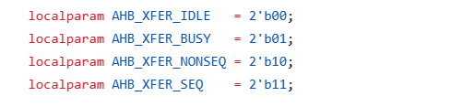
Gray Code Encoding Steps in AHB-Lite Interface
Step 1: AHB transaction starts when HTRANS = NONSEQ and a valid address arrives.
Step 2: The controller enters a Gray-coded FSM state:
IDLE = 00
BUSY = 01
NON SEQ = 1
SEQ = 10
Step 3: During transaction processing, the FSM changes as: 00 → 01 → 11 → 10 → 00
Only one bit changes in each transition.
Step 4: The FSM generates control signals such as HSEL, HREADY, and HRESP based on the current state.
Step 5: Because only one bit toggles per state change, switching activity, glitches, and power consumption in the control logic are reduced.

Slide 81
Bus Inversion Encoding
Bus inversion is used in an AHB-Lite interface mainly to reduce dynamic power consumption caused by frequent switching of wide buses like:
hwdata
hrdata
AHB-Lite data buses are usually 32-bit or 64-bit wide. During every transfer many bits toggle between 0 and 1.
Bus inversion reduces the switching activity α.

Slide 82
Steps in Bus Inversion Encoding
Start
Current Data
Compare with Previous data
Count Transition Bits
Transitions > width/2
Yes
No
Invert Data and INV=1
Send Original data INV=0
Transmit data + INV Bit
Receiver Checks Invert Bit
Recover Original Data
End
Fig 2. Bus Inversion Flow

Slide 83
Bus Inversion Encoding & Decoding in AHB Lite Interface
Start
Select Current AHB Lite Data
Compare with Previous data
Count Transition Bits
Transitions > width/2
Invert Data and INV=1
Yes
No
Send Original data INV=0
Transmit data + INV Bit
Receiver Checks Invert Bit
Recover Original Data
End
Fig 3. Bus Inversion Flow in AHB Lite Interface

Slide 84
Example Of Bus Inversion Encoding in AHB Lite Interface
1. Previous hwdata: 32'hAAAAAAAA
2. Current hwdata : 32'h55555555
3. Compare transitions between previous and current data
4. Total transitions: 32 transitions
5. Check condition(32 > 16) ? invert current hwdata: Original Data
7. Transmit: hwdata = 32'hAAAAAAAA and INV = 1
8. Receiver checks INV=1 and recovers 32'h55555555

Slide 85
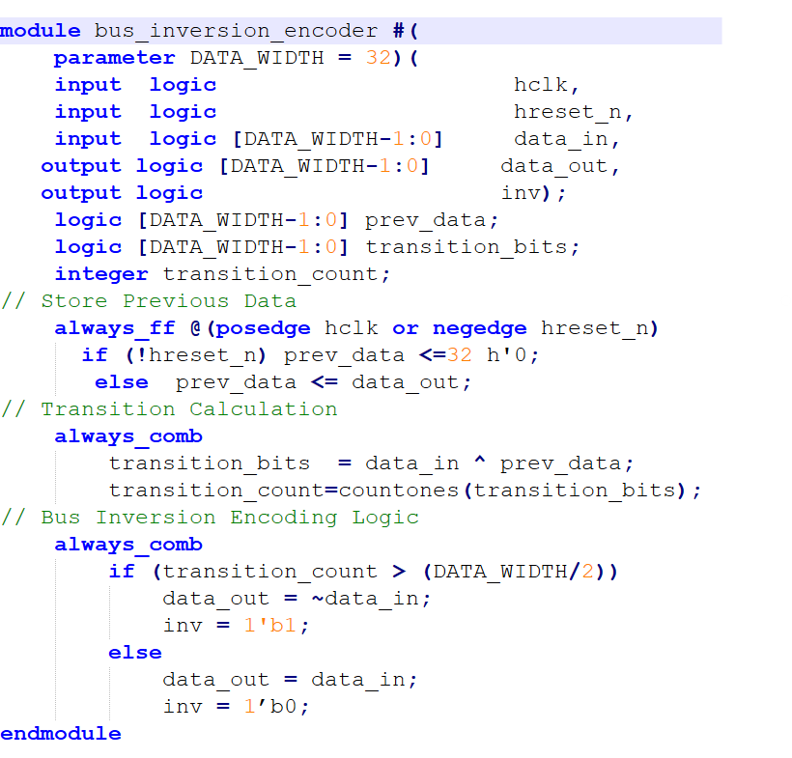
Bus Inversion Encoding Logic In AHB Lite Interface

Slide 86
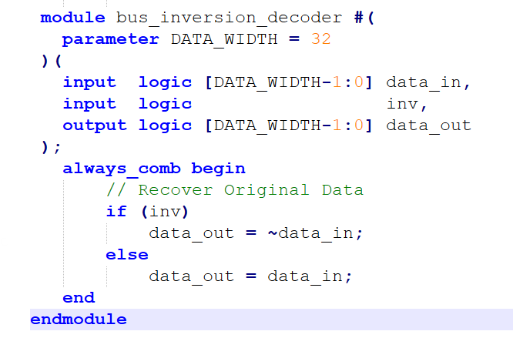
Bus Inversion Decoding Logic In AHB Lite Interface

Slide 87
Transition Inversion Introduction
Transition inversion is a low-power technique used to reduce switching activity on high-speed buses.
WHY?
If too many bits change between consecutive data, invert the current data before transmission.
Transition inversion reduces switching activity (α)
We can Calculate the transition pattern using XOR: T=P⊕C
Where:
P = Previous bus value
C = Current bus value
T = Transition pattern

Slide 88
Transition Inversion Encoding & Decoding in AHB Lite Interface
Start
Select Current AHB Lite Data
Compare with Previous data
XOR Operation between them
Transitions > width/2
Yes
No
Invert Data and INV=1
Send Original data INV=0
Transmit data + INV Bit
Receiver Checks Invert Bit
Recover Original Data
End
Fig 3. Transition Inversion Flow in AHB Lite Interface

Slide 89
Transition Inversion Encoding and Decoding Logic In AHB Lite Interface
always_comb begin transition_count = 0; for (i = 0; i < DATA_WIDTH; i = i + 1) // Compare transitions if (data_in[i] != prev_data[i]) transition_count = transition_count + 1;
always_comb if (transition_count > (DATA_WIDTH/2)) data_out = ~data_in; inv = 1'b1; else data_out = data_in; inv = 1'b0; endmodule
module ahb_transition_inversion_encoder #( parameter DATA_WIDTH = 32 )( input logic hclk, input logic hreset_n, input logic [DATA_WIDTH-1:0] data_in, output logic [DATA_WIDTH-1:0] data_out, output logic inv );
logic [DATA_WIDTH-1:0] prev_data; integer transition_count; integer i;
always_ff @(posedge hclk or negedge hreset_n) begin if (!hreset_n) prev_data <= '0; else prev_data <= data_out;

Slide 90
Transition Inversion Decoding Logic In AHB Lite Interface
module ahb_transition_inversion_decoder #(
parameter DATA_WIDTH = 32
)(
input logic [DATA_WIDTH-1:0] data_in,
input logic inv,
output logic [DATA_WIDTH-1:0] data_out
);
always_comb
if (inv) data_out = ~data_in;
else data_out = data_in;
endmodule

Slide 91
Power Reduction techniques in AXI4 to AHB Bus
Control Path
AXI Address
Handler
Burst Counter
(Gray code)
Address generator
FSM
(Gray code)
AHB Control logic
Write Data Path
AXI
WDATA
Handler
Bus
Inversion Encoder
Write data
FIFO
(Gray code)
Bus Inversion Decoder
AHB Output logic
Fig 4. Power Reduction techniques in AXI4 to AHB Bus

Slide 92
Gray Code Encoding in AXI4 to AHB Bus
Gray coding in the AXI4-to-AHB bridge is used to reduce switching activity in the FSM (Finite State Machine).
The bridge FSM controls AXI read/write transactions and AHB transfers using states such as : IDLE- CMD_RD- DATA_RD -CMD_WR -DATA_WR -DONE_RD -DONE_WR

Slide 93
Gray Code Encoding Steps in AXI4 to AHB Bus
Step 1: Identify FSM states in AXI-to-AHB bridge : IDLE, CMD_RD, DATA_RD, DONE_RD
Step 2:Check normal binary encoding
IDLE = 0000
CMD_RD = 0001
DATA_RD = 0010
DONE_RD = 0011
Step 3:Observe multiple bit transitions:0001 -> 0010(2 bits change)
Step 4:Assign Gray-coded values
IDLE = 0000
CMD_RD = 0001
DATA_RD = 0011
DONE_RD = 0010
Step 5: only one bit changes 0001 -> 0011(1 bit change)

Slide 94
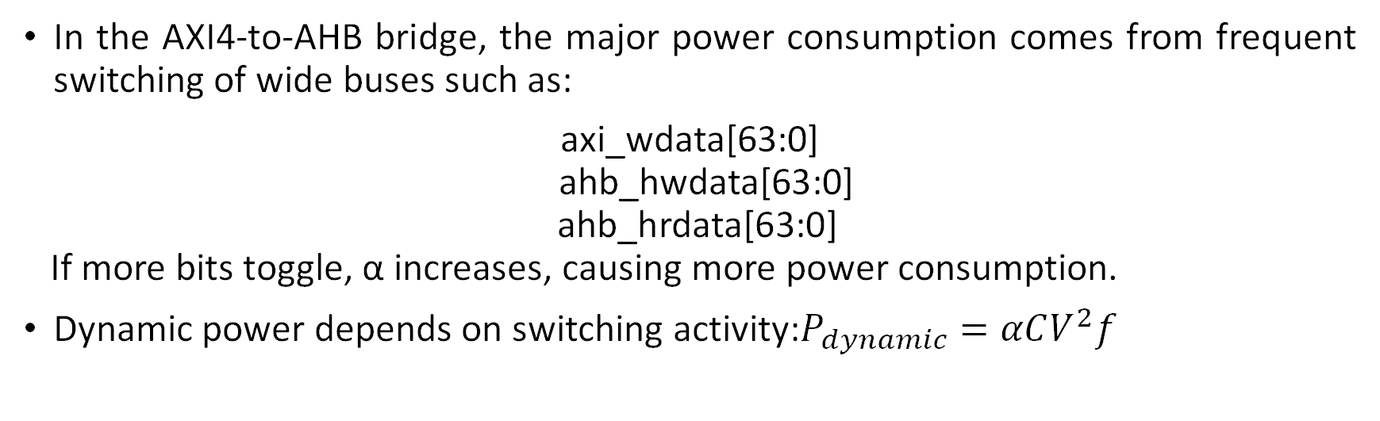
Bus Inversion Encoding in AXI4 to AHB Bus
In the AXI4-to-AHB bridge, the major power consumption comes from frequent switching of wide buses such as:
axi_wdata[63:0] ahb_hwdata[63:0] ahb_hrdata[63:0] If more bits toggle, α increases, causing more power consumption.
Dynamic power depends on switching activity:$P_{dynamic}=αCV^{2}f$

Slide 95

Bus Inversion Encoding in AXI4 to AHB Bus
Without Bus Inversion:
Apply encoder here:
Store : buf_data and inv_bit
Decode before AHB output:
wrbuf_data
Bus Inversion Encoder
encoded_data + inv_bit
buf_data + inv_bit
Bus Inversion Decoder
AHB_hwdata

Slide 96
Example Of Bus Inversion Encoding in AXI4 to AHB Bus
Let Previous Data = 64'h0000_0000_0000_0000 Current Data = 64'hFFFF_FFFF_FFFF_FFFF
Transitions = 64
Since 64 > 32:
Send: encoded_data = 64'h0000_0000_0000_0000 inv_bit = 1
Receiver:
inv_bit = 1 decoded_data = ~(encoded_data) = FFFF_FFFF_FFFF_FFFF

Slide 97


